Slide 1
AI-powered Healthcare Diagnostics Scrum Project
Team Go: Kehan Tang, Lin Yang, Yuyan Li, Zhilin Li, Zhaoju Liu, Niharika Labhsetwar

Slide 2
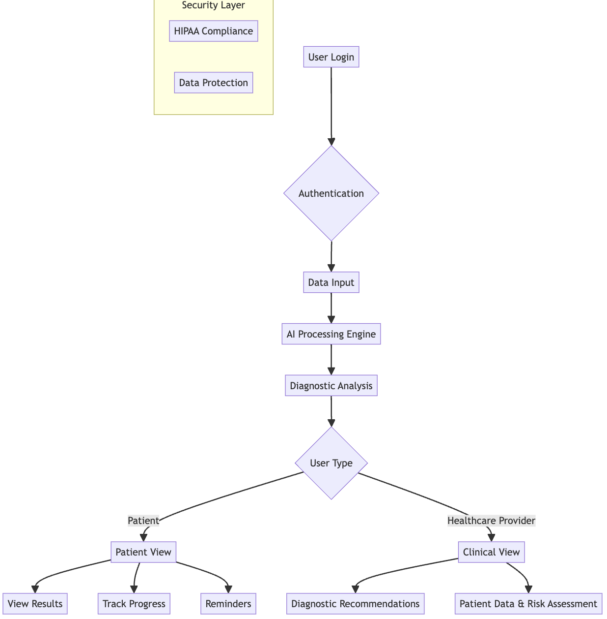
Functionality & Operation Overview
Product Overview
An AI-powered diagnostic platform providing instant, precise health insights and streamlined access to management tools. Enhances accuracy and patient engagement with robust data privacy and security.

Slide 3
Five Product Key Features
Accurate AI Diagnostics
The AI algorithm analyzes patient health data to provide reliable diagnostic results with a high accuracy rate, along with explanations and confidence scores.
2. Cross-Platform Compatibility
The app is compatible with iOS, Android, and Web platforms, providing a consistent user experience across different devices.
Accuracy
Platforms
Patients can track their treatment progress, and receive reminders for upcoming appointments to ensure they stay on their treatment plan.
3. Patient Management and Reminders
Doctors and nurses have access to the latest patient data in the app, ensuring diagnostic and treatment decisions are based on the most current information
4. Real-Time Data Updates
Patients
Data
5. Security and Privacy Protection
The app follows HIPAA privacy protocols features two-factor authentication, enforces strict access control, and undergoes regular security testing to ensure patient data is secure.

Slide 4
Our Team’s Scrum Process
Overview
Our team followed a traditional Scrum process, organizing work into iterative sprints and breaking down the project into user stories.
Each sprint began with sprint planning, where we prioritized tasks and set sprint goals. We focused on delivering shippable features of our healthcare app at the end of each sprint, which allows us to adapt quickly to feedback.
After each sprint, we conducted a retrospective to reflect on our process, which helped us refine our workflow for upcoming iterations, ensuring continuous growth and adaptation.
Tools & Documentation
User Story Tracking Template & Kanban: track user stories, sprint goals, task progress, and documentation.

Slide 5
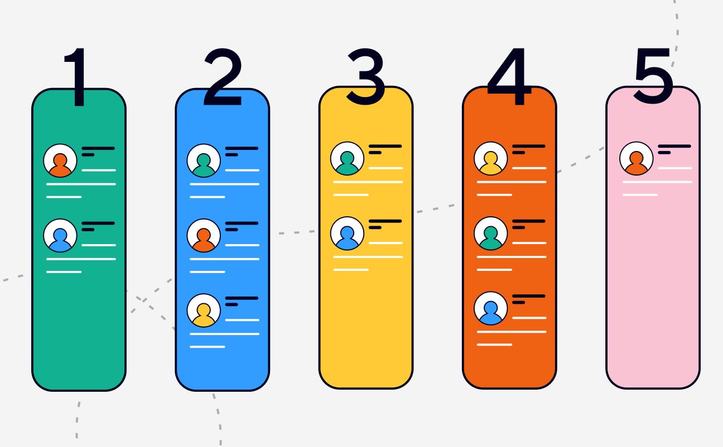
Team structure and Scrum events
Team Roles
Scrum Master: Advocate, facilitator, and coach of the scrum Process.
Product Owner: Champions and Owner of the product. Responsible for defining the vision and priorities of the project.
Development Team: Composed of cross-functional members who worked on coding, testing, and integration.
Scrum events
Backlog Grooming: Led by Product Owner to refine and prioritize user stories, clarify requirements.
Sprint Planning: Define goals, prioritize backlog, create sprint backlog.
Weekly Standups: Sync up on progress, discuss current work, identify blockers.
Sprint Reviews & Retrospectives: Demo completed work, gather feedback, and discuss improvements.

Slide 6
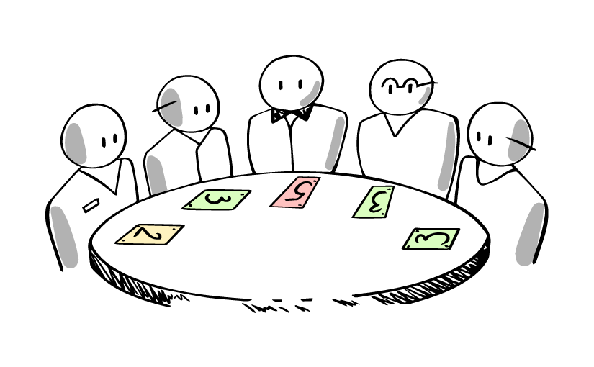
Estimation Methodologies
We used story points to measure the complexity of each task. In sprint planning, each team member decided input on the effort required for user stories, and we reached a consensus on story points based on factors like time, difficulty, and resources.
However, we found this method could sometimes be susceptible to bias. In order to make more accurate estimates, we switched to planning poker. With planning poker, team members independently selected story points before seeing others’ choice.
It reduced the chance of one person’s opinion influencing others.
It prevented anchoring bias.
This approach really helped us to manage time effectively and refine future estimates.
Notes:
Analogous Estimation: Best for initial planning stages, but needs to be refined as project is executed.

Slide 7
Sprint Stories Summary
Sprint 1: Foundations and Core Features
Sprint Planning:
Our team prioritized setting up core features, including patient data entry, initial diagnostic algorithms, and database schema. Key security protocols were discussed to ensure basic data protection, and each story was assigned based on effort estimates to establish a strong project foundation.
Daily Standups: Each day, the team synced on progress, tracking updates to the UI and backend connections and identifying any blockers in data processing.
Backlog Grooming: The Product Owner led a backlog refinement to ensure the initial stories aligned with the project vision, adding details to support future diagnostic features.
User Stories:
“I want to the AI-powered healthcare diagnostics app to provide reliable and accurate disease detection”
“I want to access AI-generated diagnostic recommendations from patient data”
“The AI-powered diagnostic app to integrate medical imaging (X-rays, CT scans, MRI) with AI-based analysis”
Sprint Review & Retrospective:
Demoed the app’s initial patient data input interface and basic diagnostic algorithm. Stakeholder feedback highlighted the need for improvements in UI clarity. The retrospective focused on cross-functional collaboration and laying out security protocols for further iterations.

Slide 8
Sprint Stories Summary
Sprint 2: Patient Management and Diagnostic Accuracy
Sprint Planning:
This sprint focused on refining the diagnostic algorithm for higher accuracy and adding patient management tools like a treatment tracking dashboard. Our team discussed dependencies between back-end and front-end tasks, breaking down stories to ensure a smooth workflow with accurate, informative diagnostic results.
User Stories:
‘The app to allow me to track medication adherence and reminders.’
‘The app to help me track my treatment progress and compare my current condition with past diagnostics’
‘I want a database schema that stores appointment details (such as date, time, type of appointment, and diagnosis type)’
‘The app to send me reminders for upcoming appointments related to my diagnosis’
Sprint Review & Retrospective:
The team showcased the diagnostic algorithm with confidence scores and the initial patient management dashboard, allowing users to track treatment progress. Stakeholders provided feedback on displaying diagnostic explanations more clearly. The team planned better coordination for algorithm and UI improvements.

Slide 9
Sprint Stories Summary
Sprint 3: Cross-Platform Compatibility
Sprint Planning:
The goal was to make the app functional across iOS, Android, and web platforms. The team prioritized stories for platform-specific adjustments and responsive design. A testing strategy was outlined to catch compatibility issues, with extra time allocated for adjustments on different devices.
User Stories:
“I want the app to be able to used on different type of phones”
‘Need the app to be compatible with our existing hospital information system’
Sprint Review & Retrospective:
The demo included app performance across multiple platforms and devices. Feedback centered on minor adjustments for device consistency. The retrospective highlighted the need to integrate compatibility testing earlier in the sprint to address inconsistencies promptly.

Slide 10
Sprint Stories Summary
Sprint 4: Real-Time Data and Security Enhancements
Sprint Planning:
The team planned for real-time data syncing and strengthened security features, including HIPAA compliance and two-factor authentication. Stories were reviewed with a focus on security and data integrity, and resources were allocated to address dependencies on security modules and ensure smooth data updates.
User Stories:
‘The app to follow strict privacy protocols (HIPAA compliance, secure data handling)’
‘The app to allow me to securely access my diagnostic reports while ensuring my personal
health information is protected’
‘Ensure the AI diagnostic system is secure, reliable, and compliant with healthcare data regulations’
‘I want to manage access permissions for different user roles’
Sprint Review & Retrospective:
The team demonstrated real-time updates and enhanced security features, including two-factor authentication. Stakeholders confirmed HIPAA compliance and noted the importance of seamless user authentication. In the retrospective, the team discussed improvements in data synchronization and the effectiveness of implementing security measures early in the process.

Slide 11
Sprint Stories Summary
Sprint 5: Final Polishing and User Feedback
Sprint Planning:
In the final sprint, the team focused on polishing the app based on user feedback, improving UI and performance. Stories for appointment reminders, role-based permissions, and performance optimizations were prioritized to deliver a polished, user-ready product.
User Stories:
‘I want to use an AI-powered diagnostic tool to quickly access patient data and risk assessments’
‘I want the app to update patient data in real time’
‘I want the AI model to be updated regularly based on new medical data’
Sprint Review & Retrospective:
The team presented the polished app, featuring a user-friendly interface, reliable reminders, and streamlined diagnostics. Feedback confirmed the app met expectations and was ready for rollout. The retrospective emphasized the team’s strong collaboration and alignment on security and functionality. Future improvements recommended gathering user feedback earlier for proactive adjustments.

Slide 12
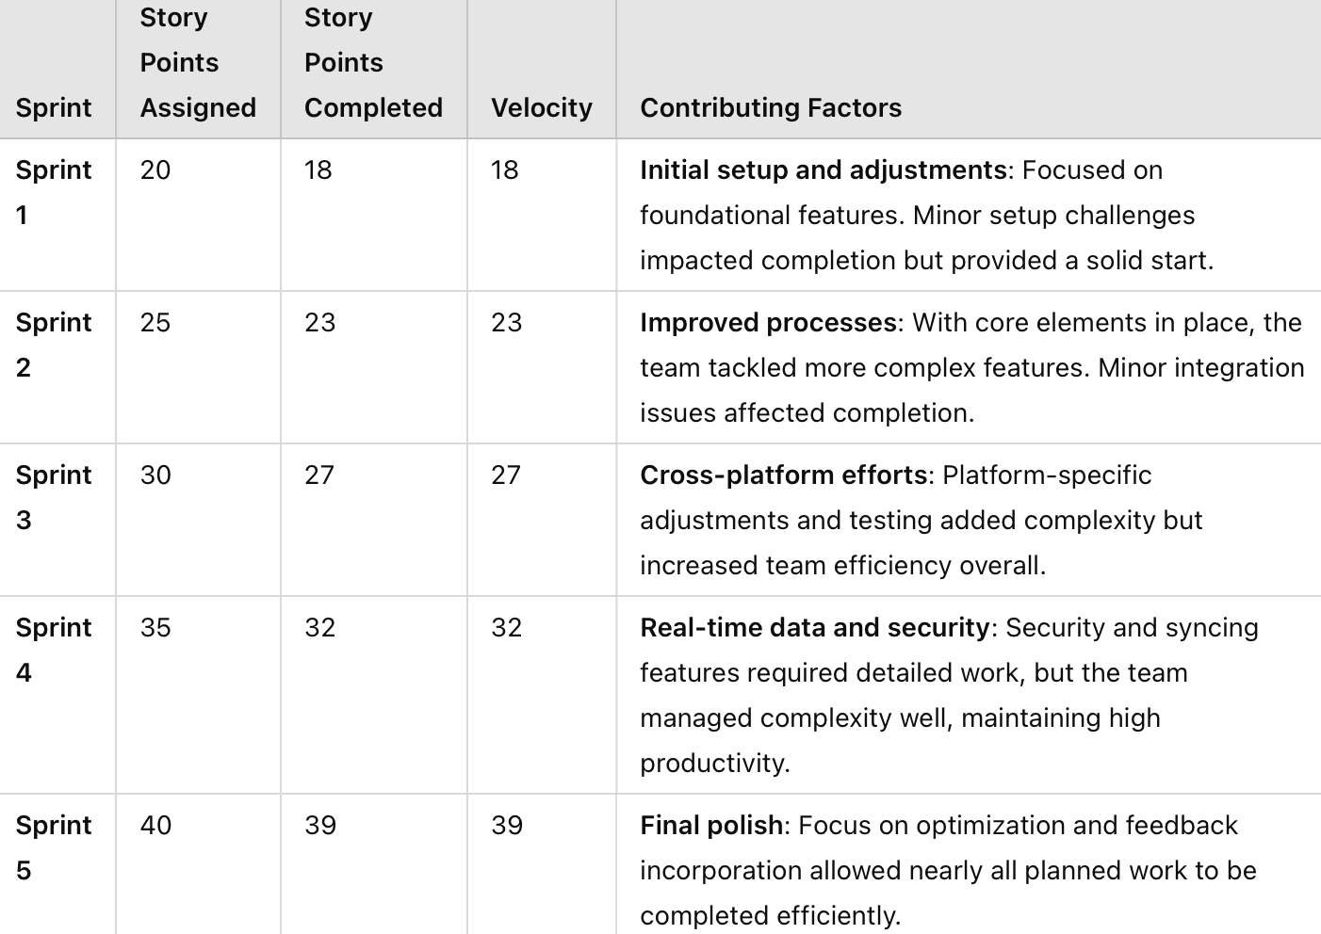
Sprint Stories Summary

Slide 13
Sprint Stories Summary
Incremental Product Development
Sprint 1-2: Established the foundation with core diagnostic features, focusing on patient data analysis and creating a simple interface for users.
Sprint 3-4: Expanded compatibility and data access, enhancing real-time information for healthcare professionals and ensuring secure handling of patient data.
Sprint 5: Completed with refinements from user feedback, optimizing the user interface and confirming final feature functionality.

Slide 14
Challenges Faced
Scrum Process
Challenges Faced
Unclear Requirements and Changing Scope
Unpredictable Iterations in AI Development
Strategies
Regular backlog refinement sessions and involve stakeholders early to gain a shared understanding. Flexible backlog that can adapt to changes, with clear prioritization.
Use a “Definition of Done” to ensure tasks are clear and achievable within a sprint.

Slide 15
Challenges Faced
AI Model Development
Challenges Faced
Optimizing the Accuracy of AI Models
Real-Time Processing Performance
Compatibility with Multiple Platforms
Strategies
AI Model Accuracy Optimization using advanced training techniques like transfer learning and hyperparameter tuning.
Improve algorithm efficiency and use high-performance computing resources, like GPUs
Develop APIs that facilitate integration with common EHR systems

Slide 16
Lesson Learned
Effective Team Practices and Collaboration
Open communication and transparency are foundational to successful teamwork. Regular check-ins kept us aligned and helped us identify potential roadblocks early.
Shorter sprints made our progress more visible. By focusing on smaller, achievable goals within each sprint, we made tangible progress each iteration.
Collaboration tools like shared Kanban boards allowed for better visualization of tasks and made it easy to understand the team's workload
Scrum and Agile Principles
Prioritizing work based on both immediate needs and longer-term goals.
Consistent sprint reviews and retrospectives
Embracing Agile principles – respond to change without feeling overwhelmed

Slide 17

Thanks!
ANY QUESTIONS?

